Slide 1


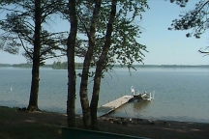
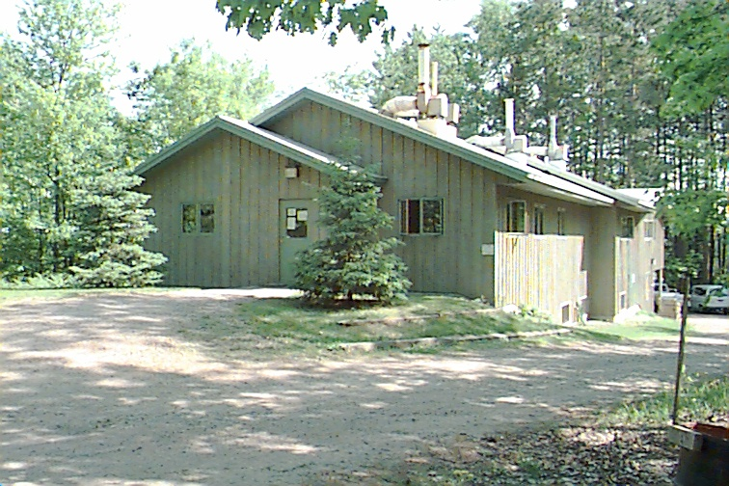
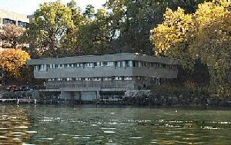

“Limnology: The study of inland waters… lakes, rivers, wetlands”
Hasler Laboratory for Limnology
Trout Lake Station
Notes:
The Center for Limnology has two facilities
The Laboratory of Limnology recently renamed Hasler laboratory after Art Hasler, who was credited with discovering how salmon find their way back to spawning grounds through their sense of smell.

Slide 2
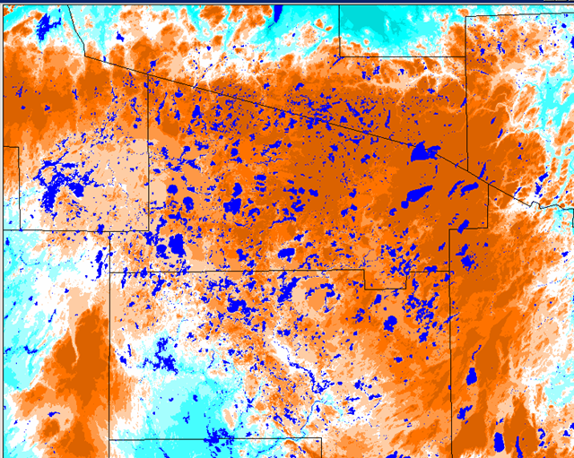
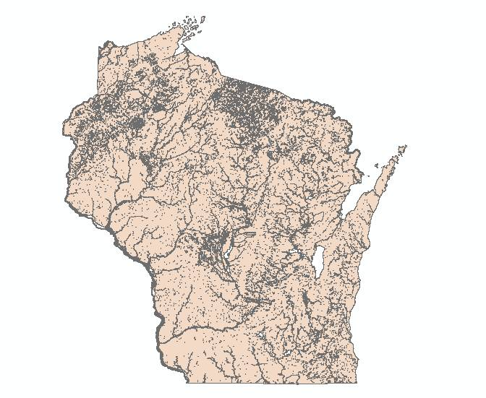
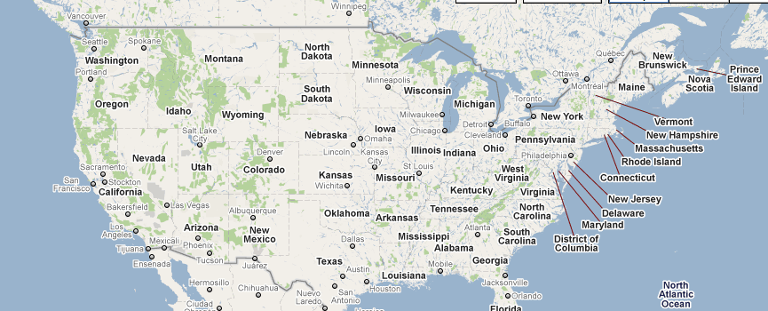
Northern Highlands Lake District
Trout Lake Station
Notes:
Wisconsin is a state rich in aquatic resources.
Wisconsin has approximately 14 thousand lakes and 65,000 Km of streams.
The NHLD of northern Wisconsin, shown in this inset has approximately 7,500 lakes.

Slide 3
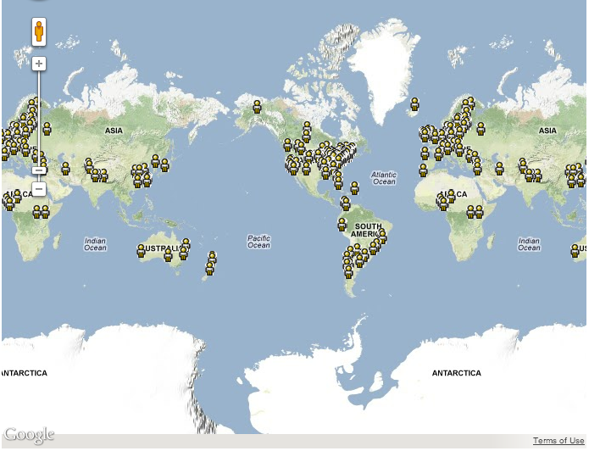
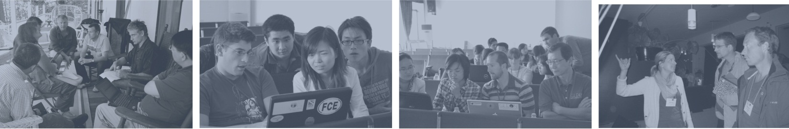
GLEON
Global Lake Ecological Observatory Network
^{Argentina}
^{Australia}
^{Austria}
^{Brazil}
^{Canada}
^{Chile}
^{China}
^{Colombia}
^{Denmark}
^{Estonia}
^{Finland}
^{Germany}
^{Hungary}
^{India}
^{Ireland}
^{Israel}
^{Italy}
^{Kenya}
^{Netherlands}
^{New Zealand}
^{Nigeria}
^{Pakistan}
^{Poland}
^{Puerto Rico}
^{Russia}
^{South Korea}
^{Spain}
^{Sweden}
^{Switzerland}
^{Taiwan}
^{Turkey}
^{United Kingdom}
A grass-roots network…

Slide 4
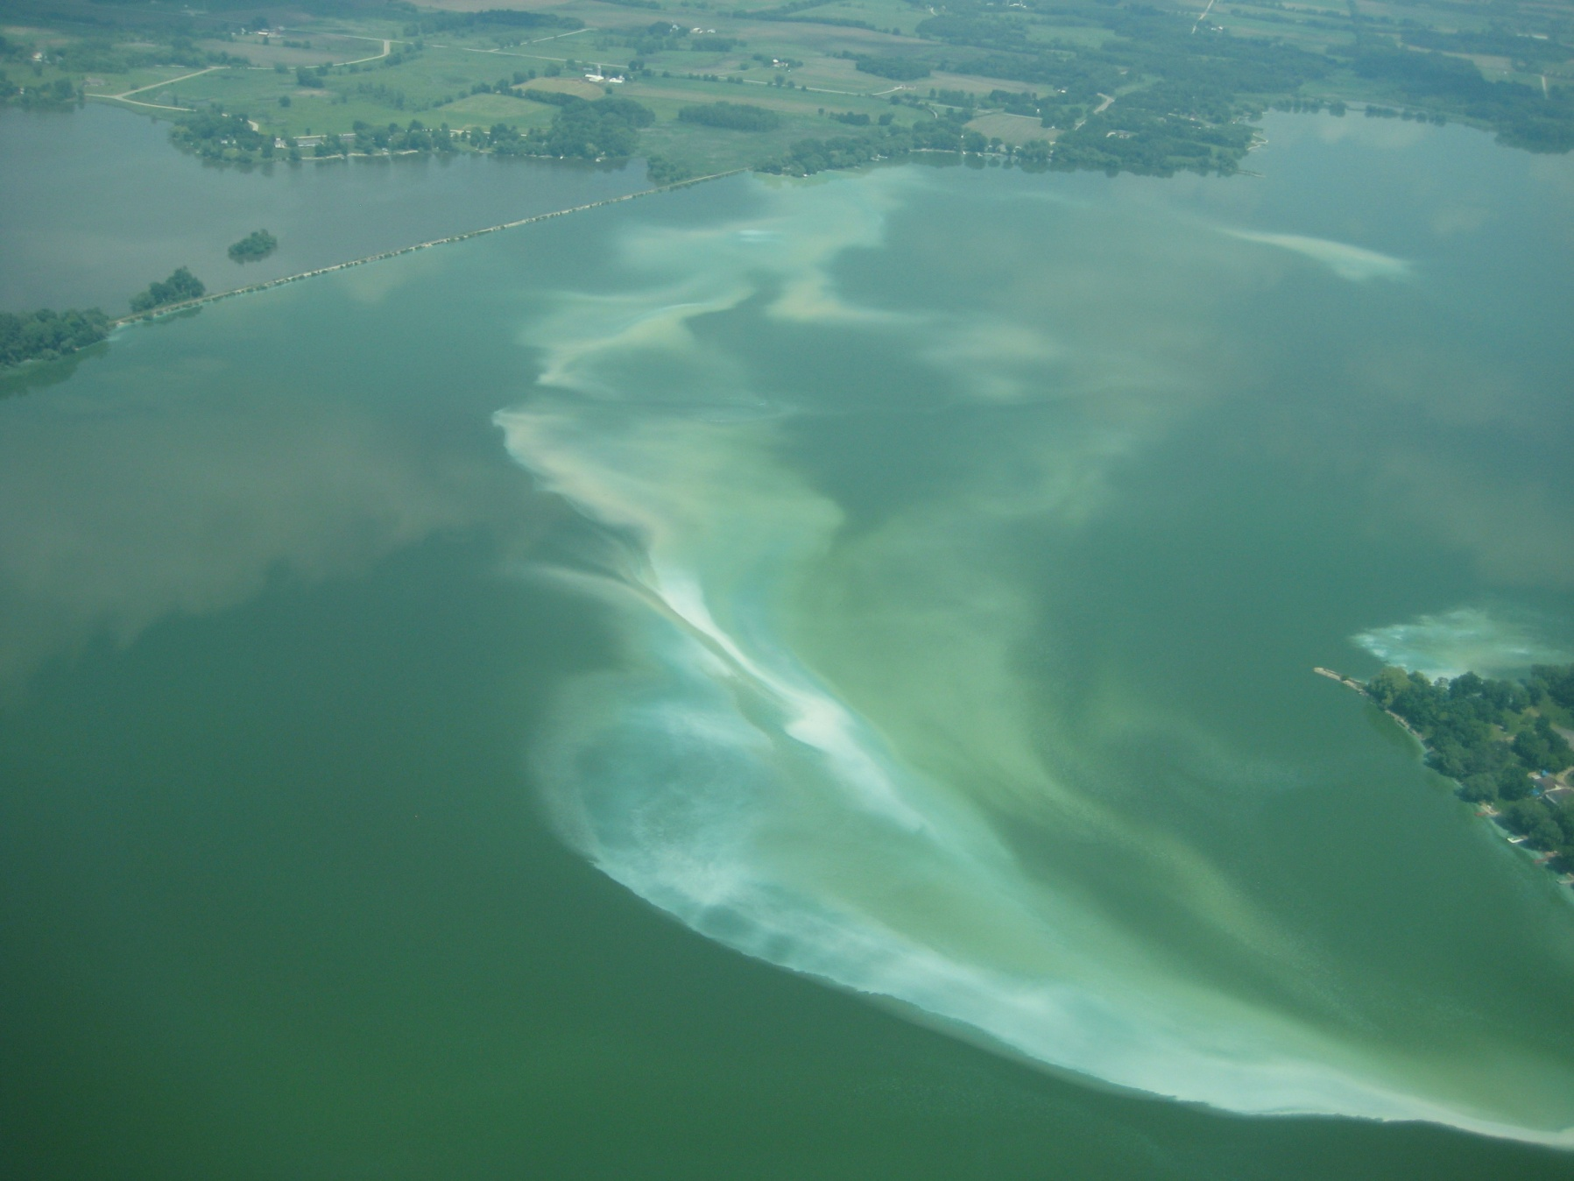
PRAGMA Expedition
Understanding and predicting phytoplankton communities in eutrohic lakes
Bloom in Beaver Dam Lake early in the summer.
Slide courtesy Jim Vennie

Slide 5
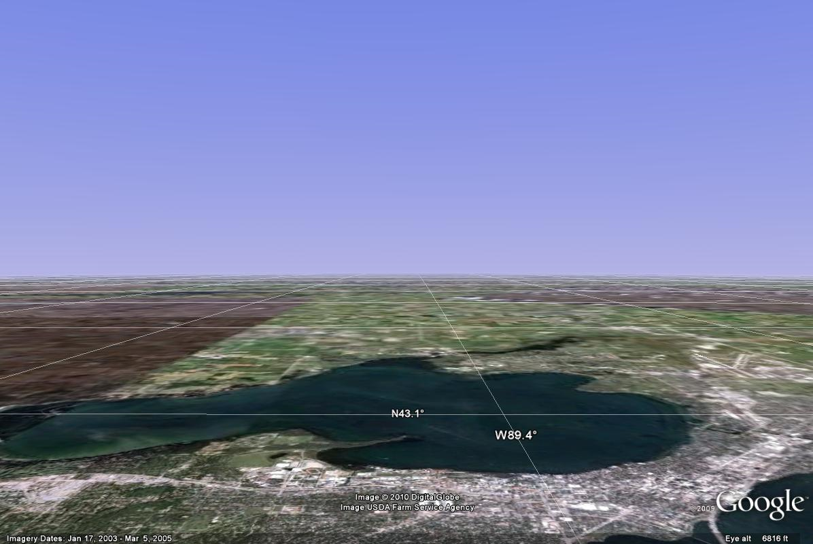
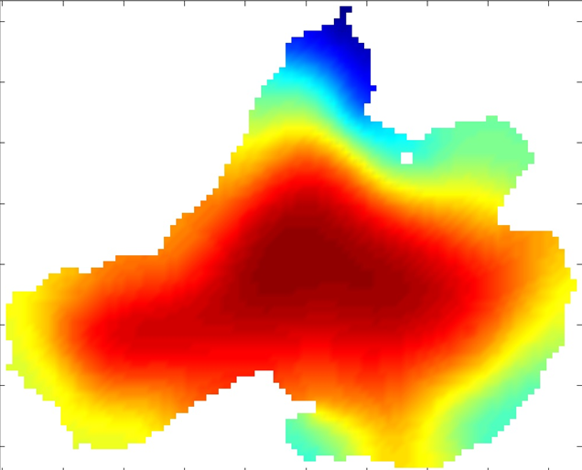
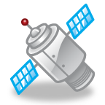
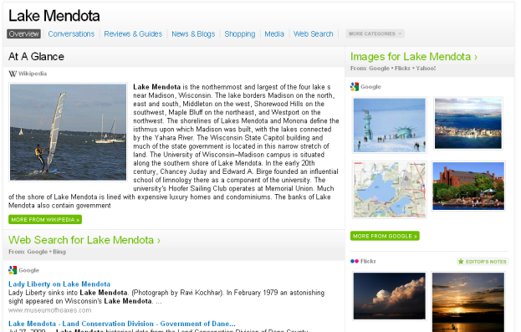
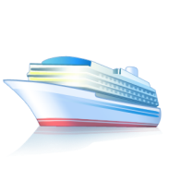
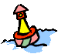

Model simulations to
Understand how the system works
Predict responses to changes
Rates
Derived ecosys
Model parameters
…
Spatial data
Satellite
Video
Cell phone
…
Organismal data
Phytoplankton
Zooplankton
…
Sensor data
Meteorological
Limnological
…
Dimensioned data
Absorbance
EEMS
…
Traditional data
PO4
Chla
…
System attributes
(unstructured data)
Algal bloom
Surface scum
Odor
C source/sink
Clear water
…

Slide 6
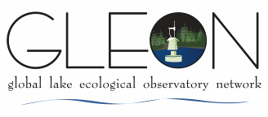

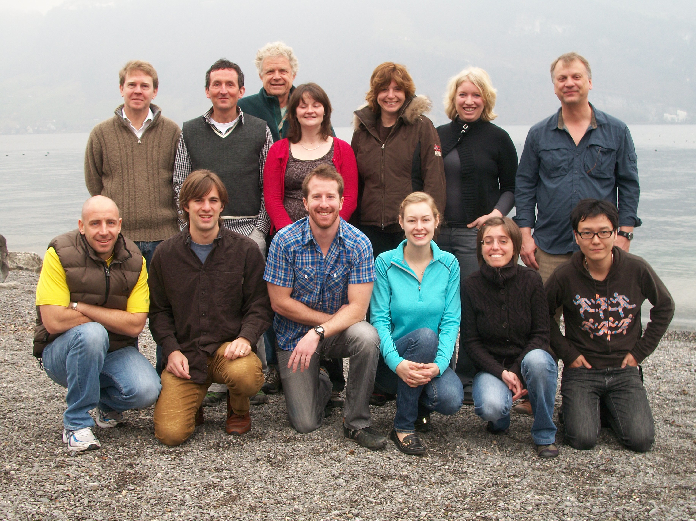




Numerical simulations
Condor
Interpretation
Answering science questions
Scaling computation
Visualization
Tracking numerical experiments
Spanning networks

